Slide 1


Slide 2

Team Leader
Elfares Howera
Team Members
Saeed El-Gharabawy Abdulrahman Alaa Abdulrahman Wael Mohab Ahmed Ibrahim Nasr

Slide 3
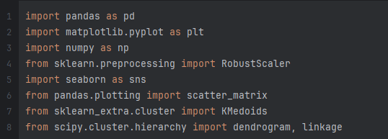
Team Leader
Elfares Howera
To Begin, these are the libraries we had to Import so that our code runs smoothly and satisfies the project needs.
Team Members
Saeed El-Gharabawy Abdulrahman Alaa Abdulrahman Wael Mohab Ahmed Ibrahim Nasr

Slide 4
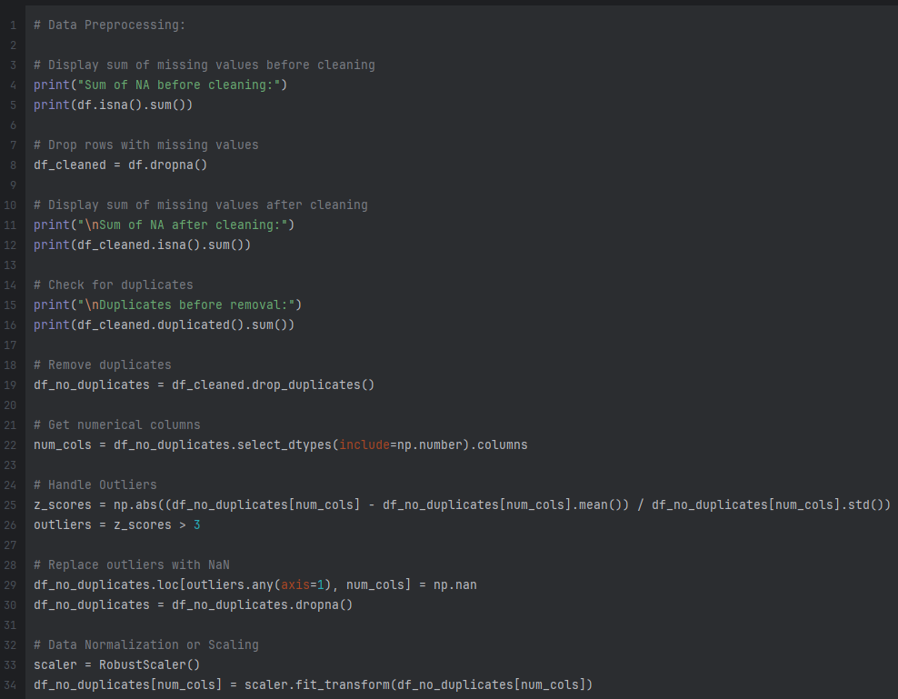
To Begin, these are the libraries we had to Import so that our code runs smoothly and satisfies the project needs.
This is where we have done the preprocessing to our data.
We displayed the sum of missing values before cleaning.
We dropped all the rows with missing values.
We checked for and removed all the duplicates present.
We handled all the inconsistencies and the outliers.

Slide 5
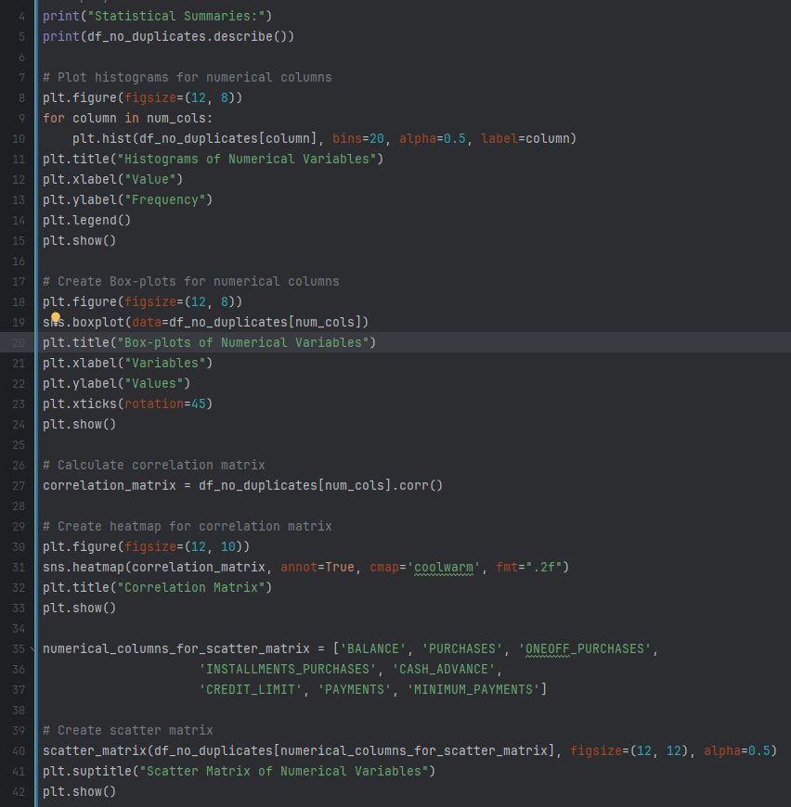
This is where we have done the preprocessing to our data.
We then did Exploratory Data Analysis (EDA)
We’ve Plot histograms for selected numerical columns.
We’ve Created a heatmap for correlation matrix.
We’ve Created a scatter matrix.
We’ve Created and plotted box-plots.
We displayed the sum of missing values before cleaning.
We dropped all the rows with missing values.
We checked for and removed all the duplicates present.
We handled all the inconsistencies and the outliers.

Slide 6
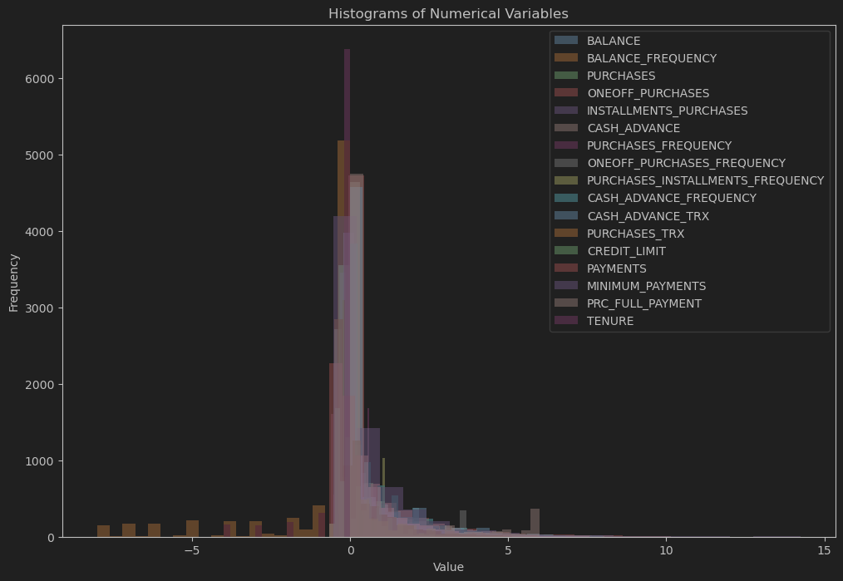
We then did Exploratory Data Analysis (EDA)
This is our histogram plot
We’ve Plot histograms for selected numerical columns.
We’ve Created a heatmap for correlation matrix.
We’ve Created a scatter matrix.
We’ve Created and plotted box-plots.

Slide 7
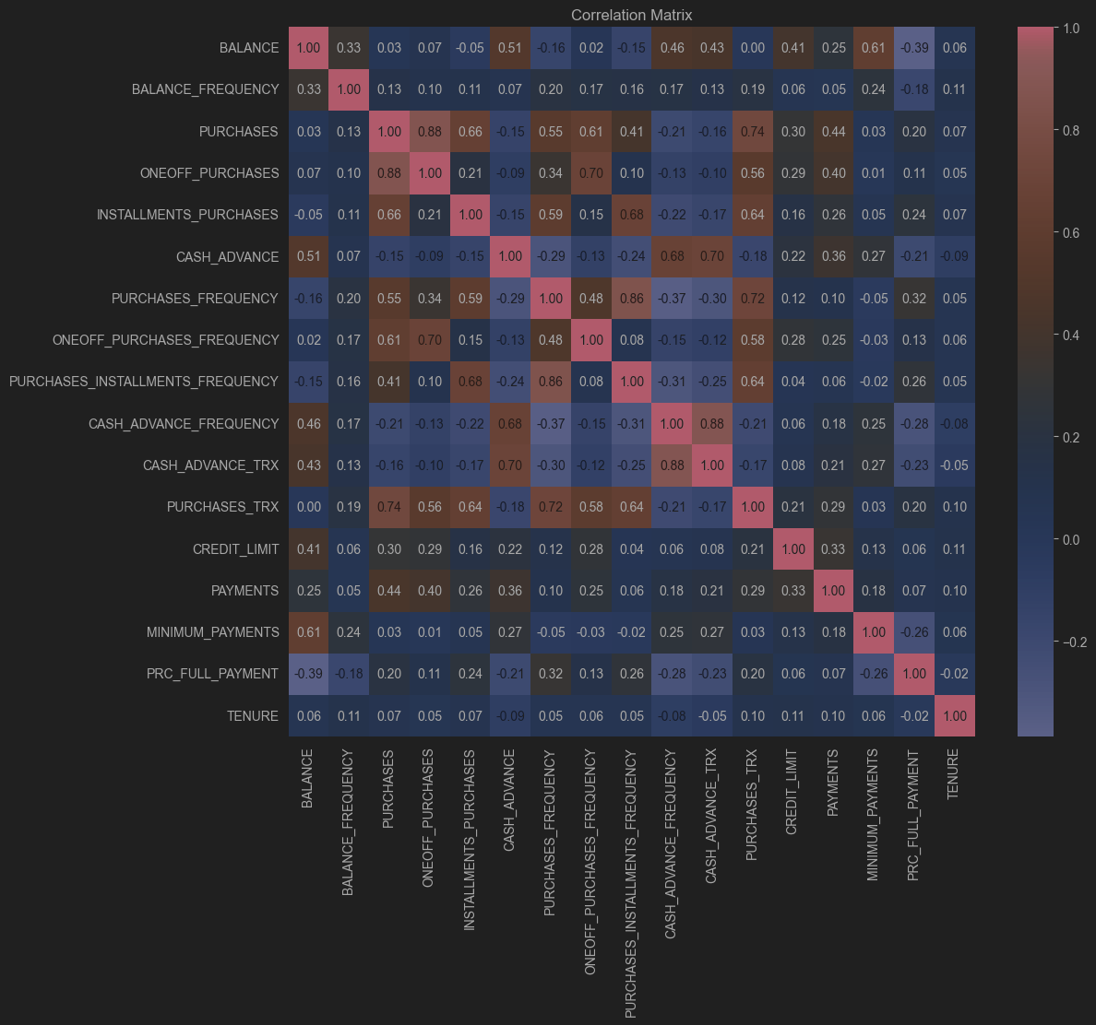
This is our histogram plot
This is our Correlation Matrix.

Slide 8
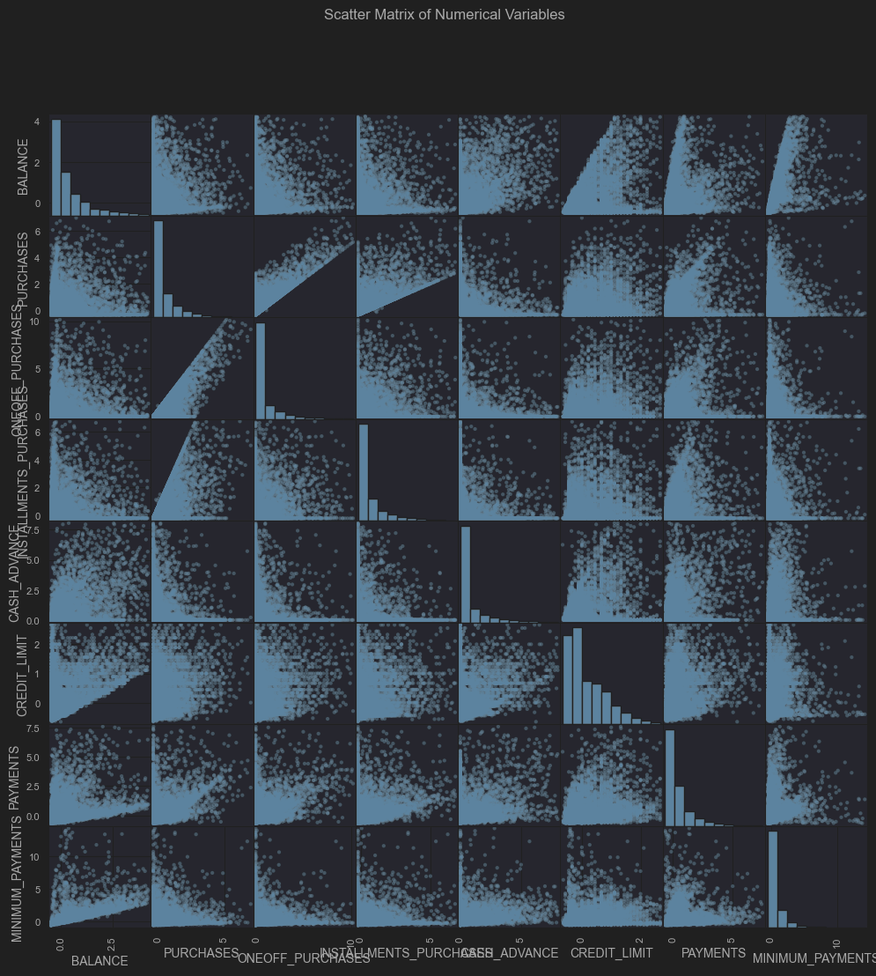
This is our Correlation Matrix.
This is our Scatter Matrix.

Slide 9
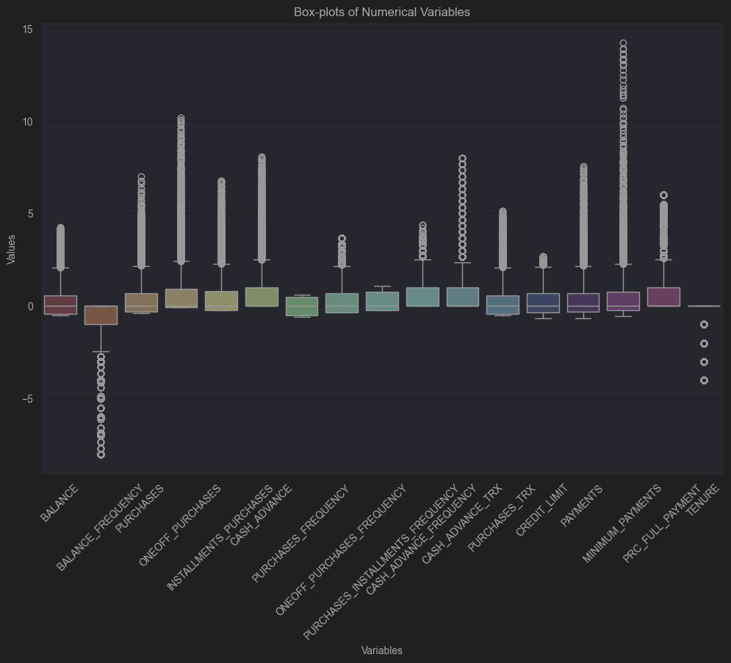
This is our Scatter Matrix.
These are our Box-Plots.

Slide 10
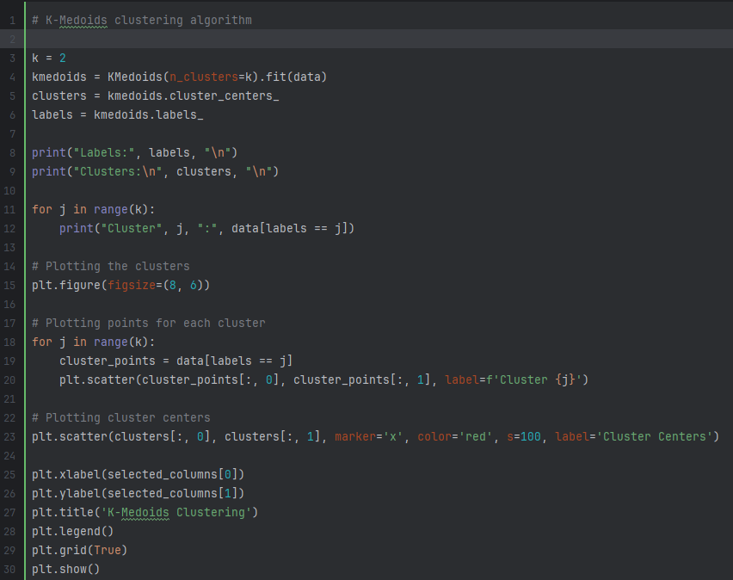
These are the other Box-Plots using normal plotting.
Here We have done K-Medoids Clustering
We have Plotted the clusters then our points for the cluster and finally the cluster centers

Slide 11
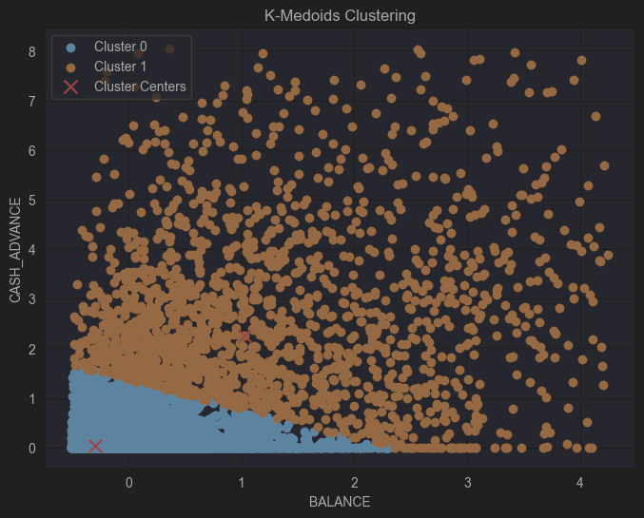
Here We have done K-Medoids Clustering
This is our K-Medoids Clustering
We have Plotted the clusters then our points for the cluster and finally the cluster centers

Slide 12
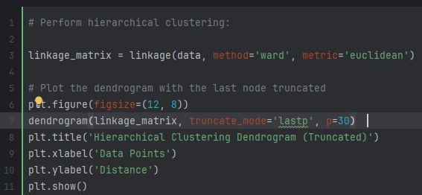
This is our K-Medoids Clustering
Here we have performed Hierarchical Clustering

Slide 13
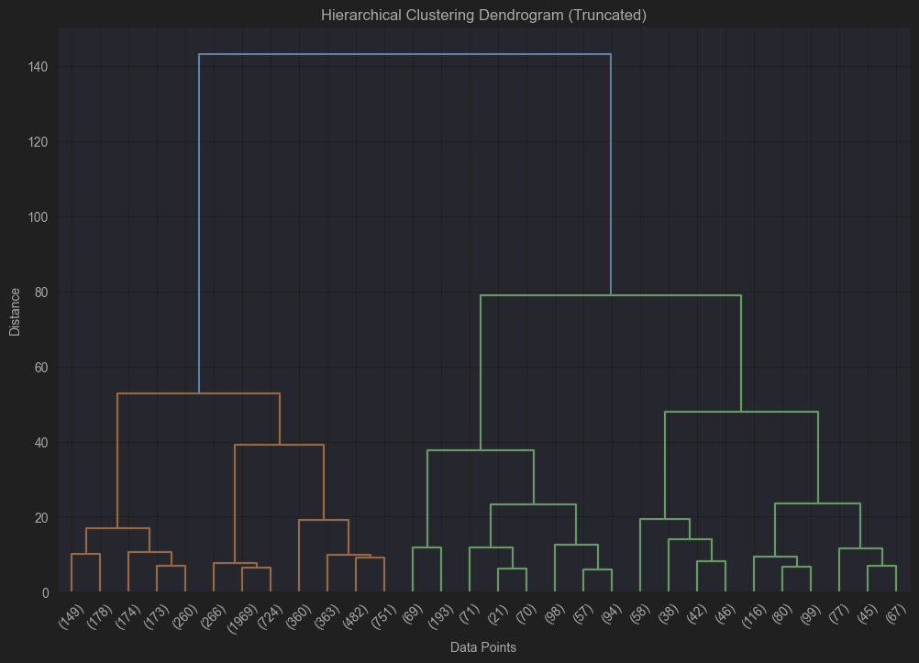
Here we have performed Hierarchical Clustering
This is our Hierarchical Clustering Dendrogram

Slide 14
This is our Hierarchical Clustering Dendrogram
End Of Code.
At this point, we have thoroughly discussed the contents of the code, highlighting both its advantages and disadvantages. Moving forward, we will explore several additional considerations that have emerged during our review. We will conclude with a brief summary and key takeaways in our final slide.

Slide 15
End Of Code.
PROS
CONS
Removing rows with missing values and isolating outliers significantly enhanced the efficiency of our data. Additionally, visualization proved to be an effective method for demonstrating the quality of our data.
The visualizations presented challenges in clarity due to the aggregation of multiple graphs within a single chart. Additionally, the extensive length of the code required significant effort and time to develop.
At this point, we have thoroughly discussed the contents of the code, highlighting both its advantages and disadvantages. Moving forward, we will explore several additional considerations that have emerged during our review. We will conclude with a brief summary and key takeaways in our final slide.

Slide 16
PROS
CONS
Removing rows with missing values and isolating outliers significantly enhanced the efficiency of our data. Additionally, visualization proved to be an effective method for demonstrating the quality of our data.
The visualizations presented challenges in clarity due to the aggregation of multiple graphs within a single chart. Additionally, the extensive length of the code required significant effort and time to develop.

Slide 17
PROS
CONS
Removing rows with missing values and isolating outliers significantly enhanced the efficiency of our data. Additionally, visualization proved to be an effective method for demonstrating the quality of our data.
The visualizations presented challenges in clarity due to the aggregation of multiple graphs within a single chart. Additionally, the extensive length of the code required significant effort and time to develop.

Slide 18
THANK YOU
This data mining project significantly improved our technical abilities and understanding of data analytics applications. We overcame challenges and leveled up our skills in data cleaning and visualization and learned the importance of precision in data handling. The experience gained will hopefully enhance our future projects.

Slide 19
THANK YOU

